Slide 1

Open Source Data Processing with OpenDroneMap
Corey Snipes
DroneCamp
July 28, 2021

Slide 2
Agenda
Background
Hands-On: Start Processing
Outputs
Using ODM
Learning Resources
Hands-On: Exercises

Slide 3
Background

Slide 4
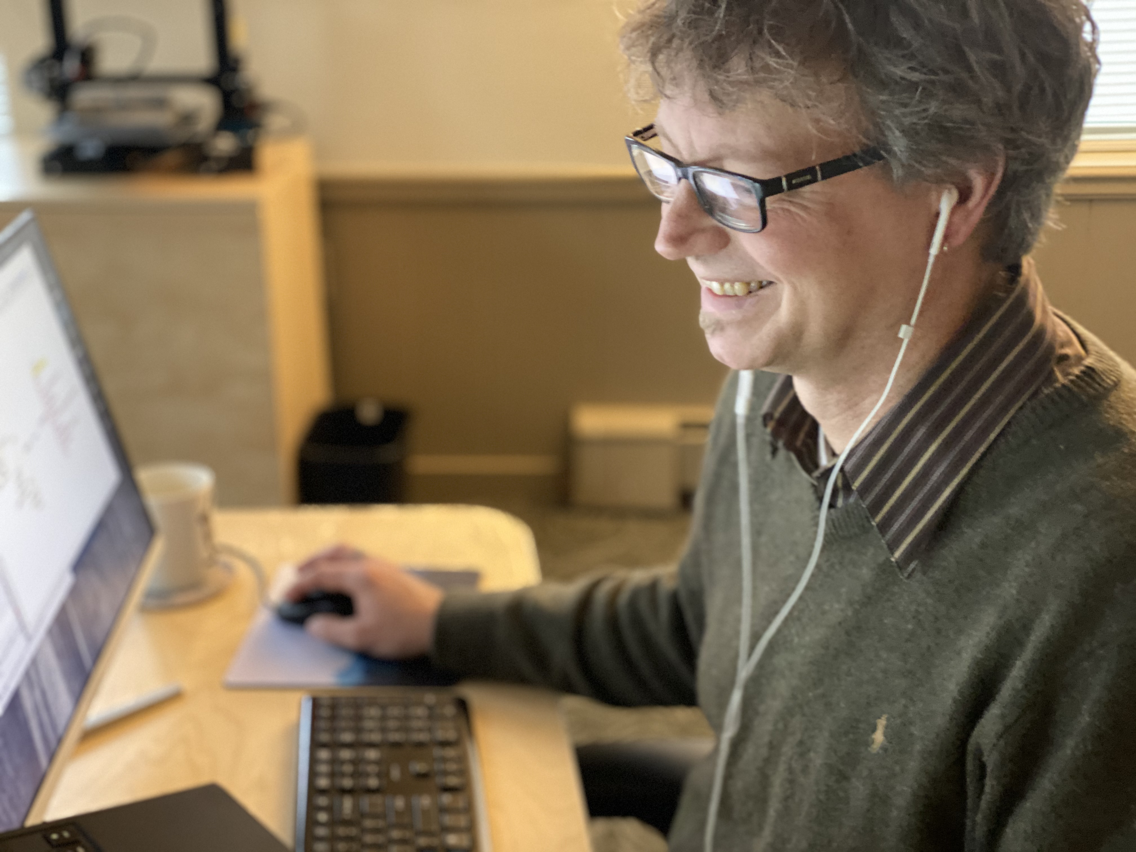
About Me
Aviation Software Engineer
Part 107 Remote Pilot
North Coast Drone Alliance
OpenDroneMap Contributor
UN OpenGIS ODM Expert Group

Slide 5
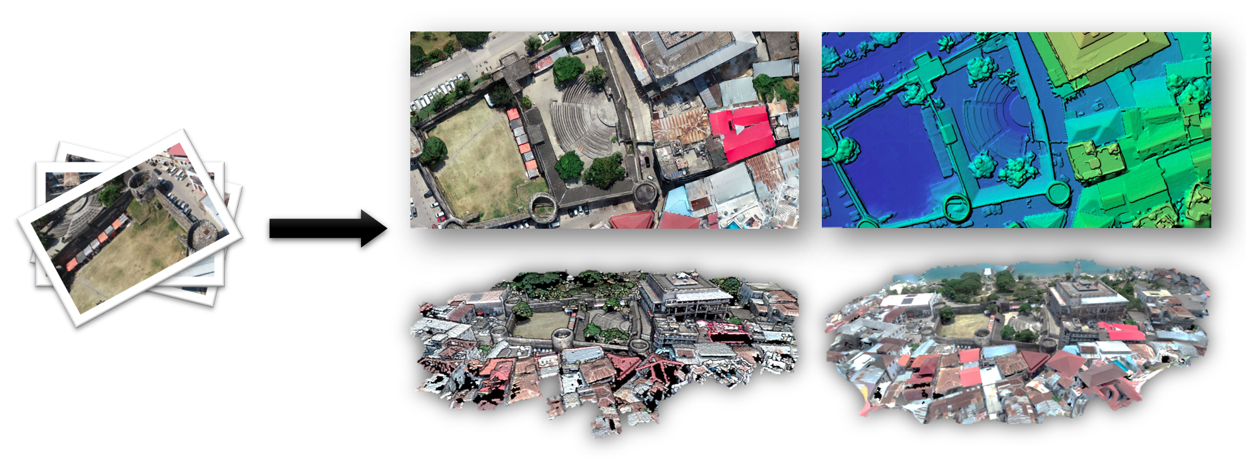
What is ODM?
Open-source toolkit for photogrammetry from UAS imagery and sensor data
Georeferenced 2D and 3D outputs
Orthophoto, DSM, DTM
Point Cloud, Textured Mesh
Used globally by universities and research programs
Used by the Red Cross, World Bank, United Nations
Begun in 2014, significant improvements 2018-2021
Output Quality
Features
Usability

Slide 6
Why Open Source?
FOSS is popular in academic and research settings, but why?
Accessible to orgs and programs with limited budgets
Pix4D is $292-$350/mo -OR- $4,990 one-time
ODM is $0* (free forever)
But equally important:
Control over your toolchain (change if you want)
Shoulders of giants: many contributors, collective wisdom
Transparency leads to greater
Quality
Security
*You can pay for certain parts, but not required.

Slide 7
ODM History
End of 2013 - Began as a joke on Geohipster
End of 2014 - Funded, organized FOSS project with multiple contributors
2015-2018 - Quietly expanded and refined tools and workflow
2018-2021 - Significant UI/ feature improvements, wider adoption
Today - Active community of international users, contributors

Slide 8
ODM Goals
Humanitarian
Ecology, conservation
Research
Data for the public good

Slide 9
Hands-On: Part A
Start Processing

Slide 10
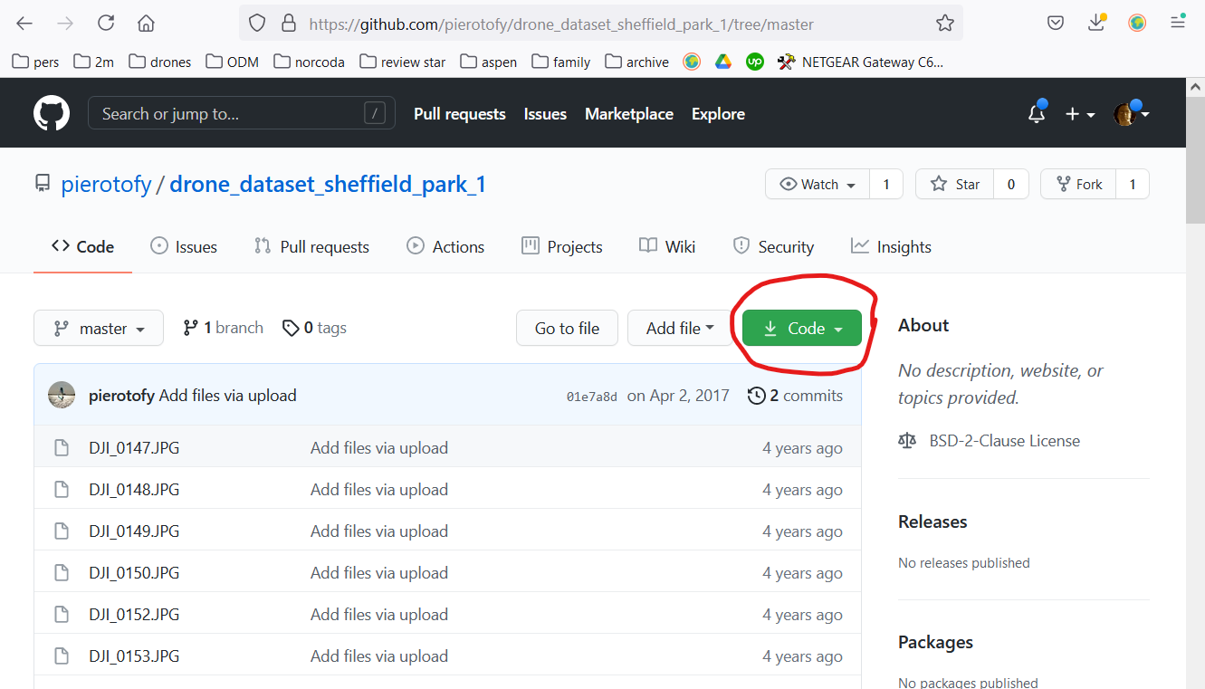
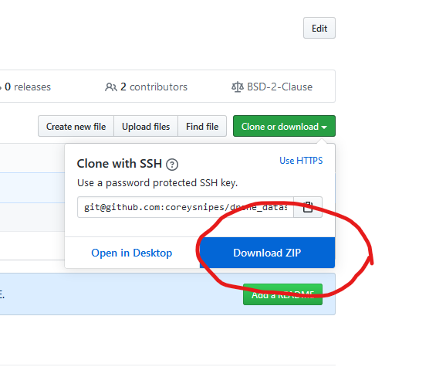
Download Sample Data
https://github.com/pierotofy/drone_dataset_sheffield_park_1/tree/master

Slide 11
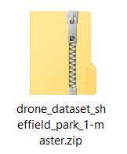
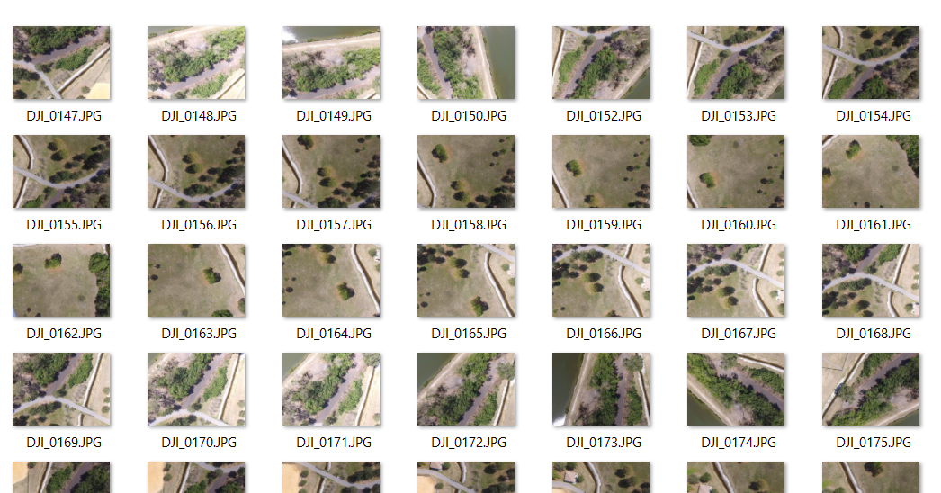
Unzip Files

Slide 12
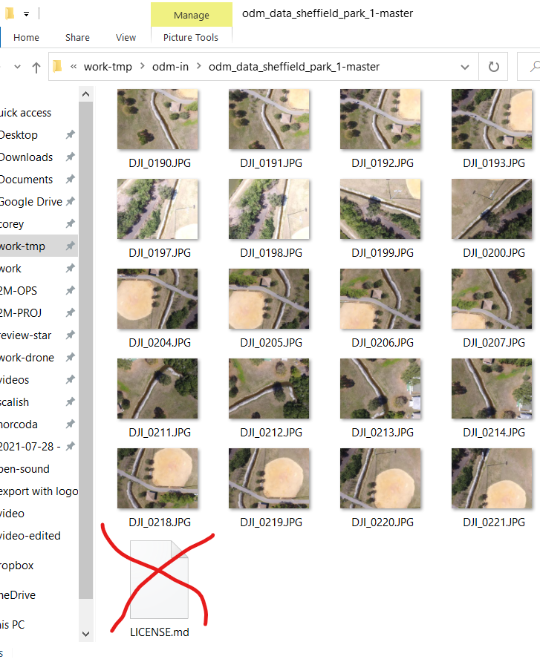
Remove LICENSE.md file

Slide 13
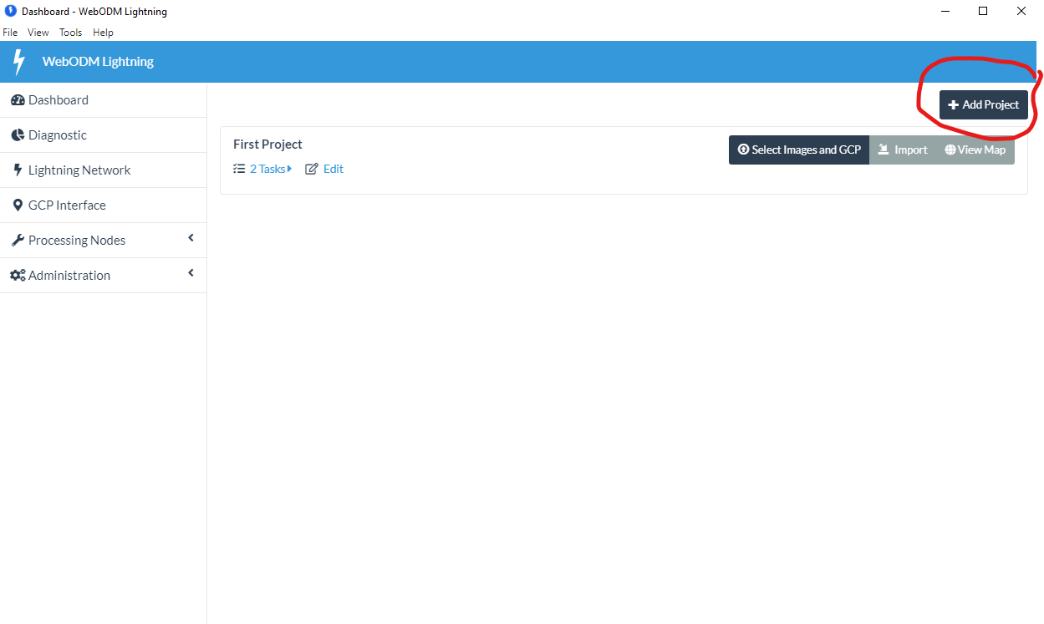
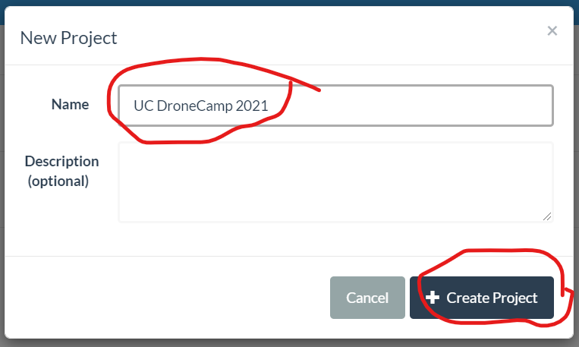
Open WebODM Lightning

Slide 14
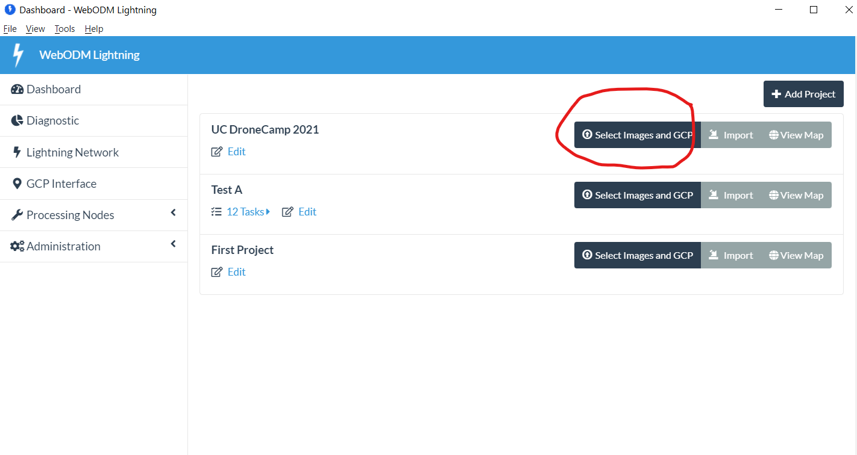
Add Images

Slide 15
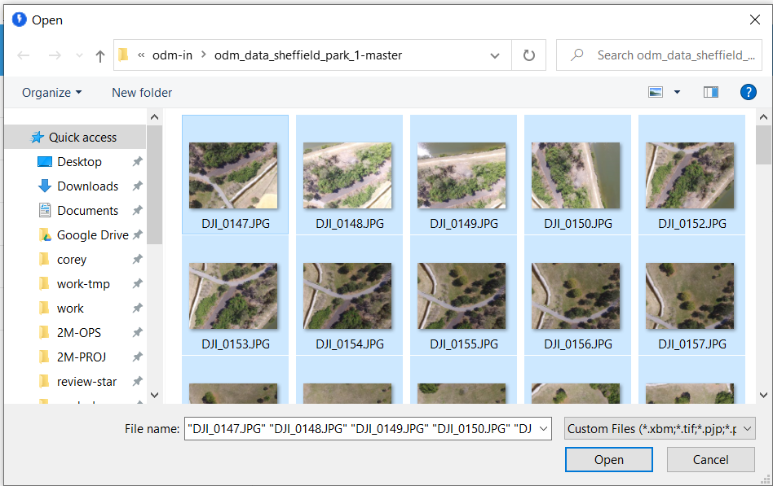
Add Images
(No Ground Control Points, today)

Slide 16
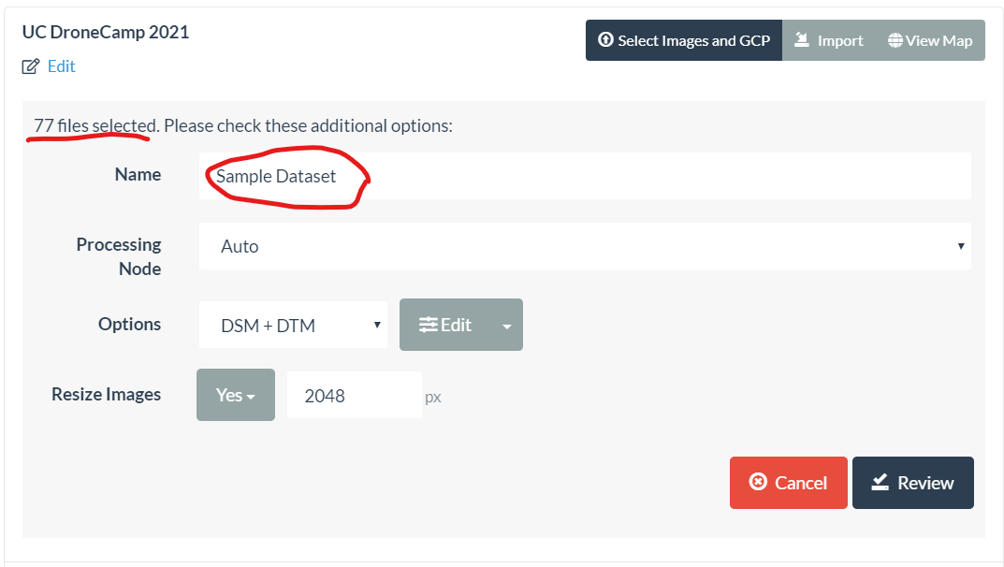
Set Configuration

Slide 17
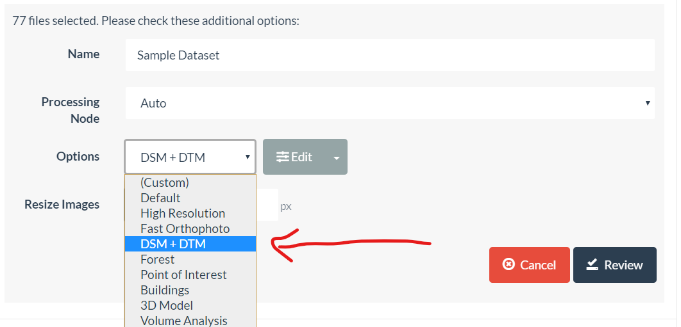
Set Configuration

Slide 18
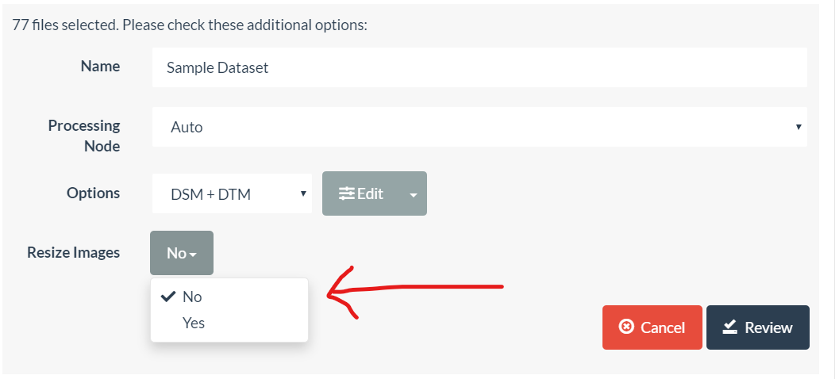
Set Configuration

Slide 19
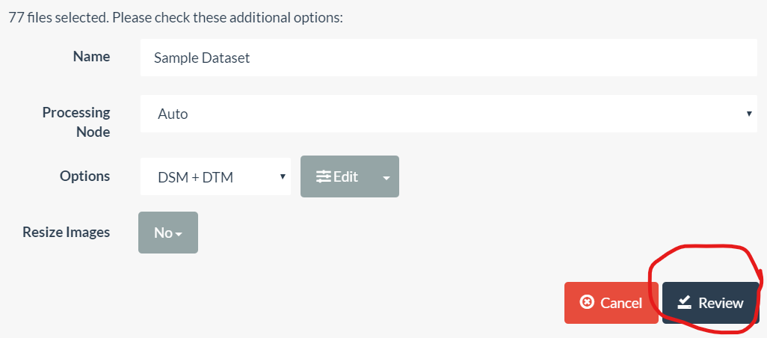
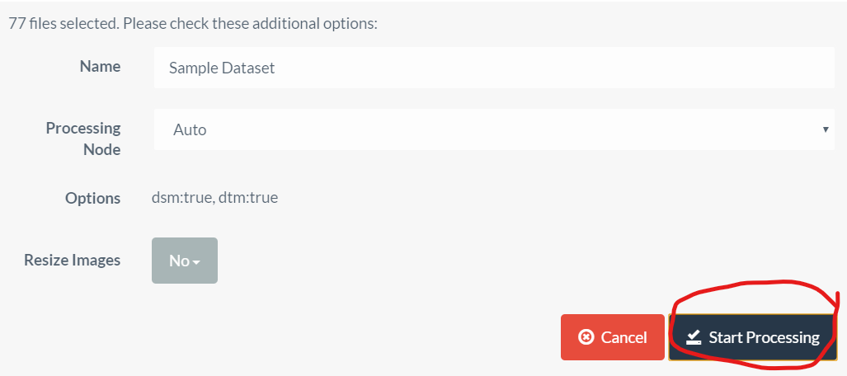
Start Processing

Slide 20
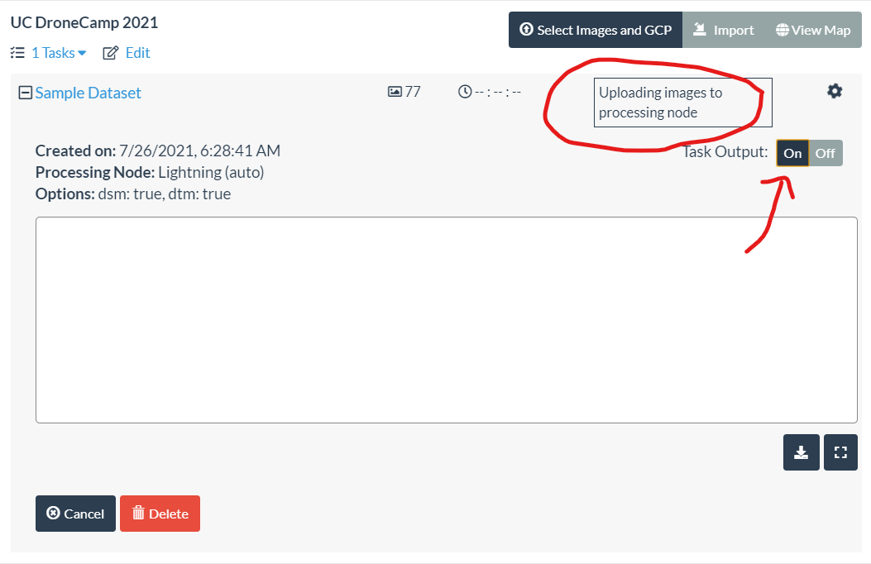
Processing Status

Slide 21
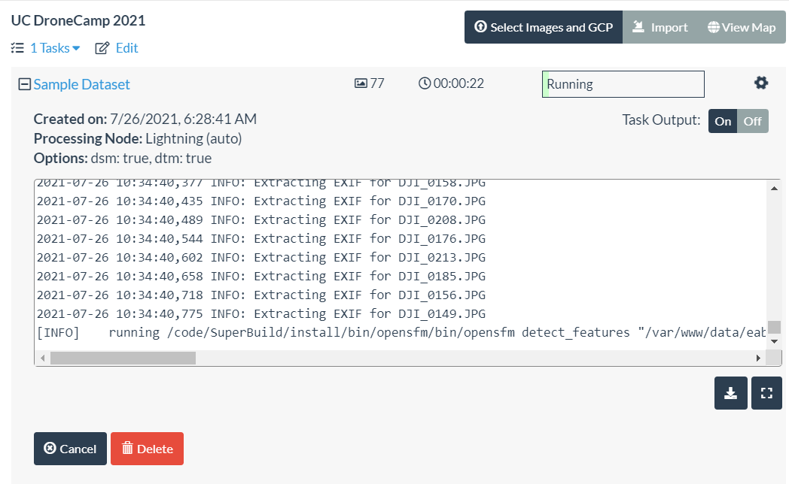
Running

Slide 22
Outputs

Slide 23
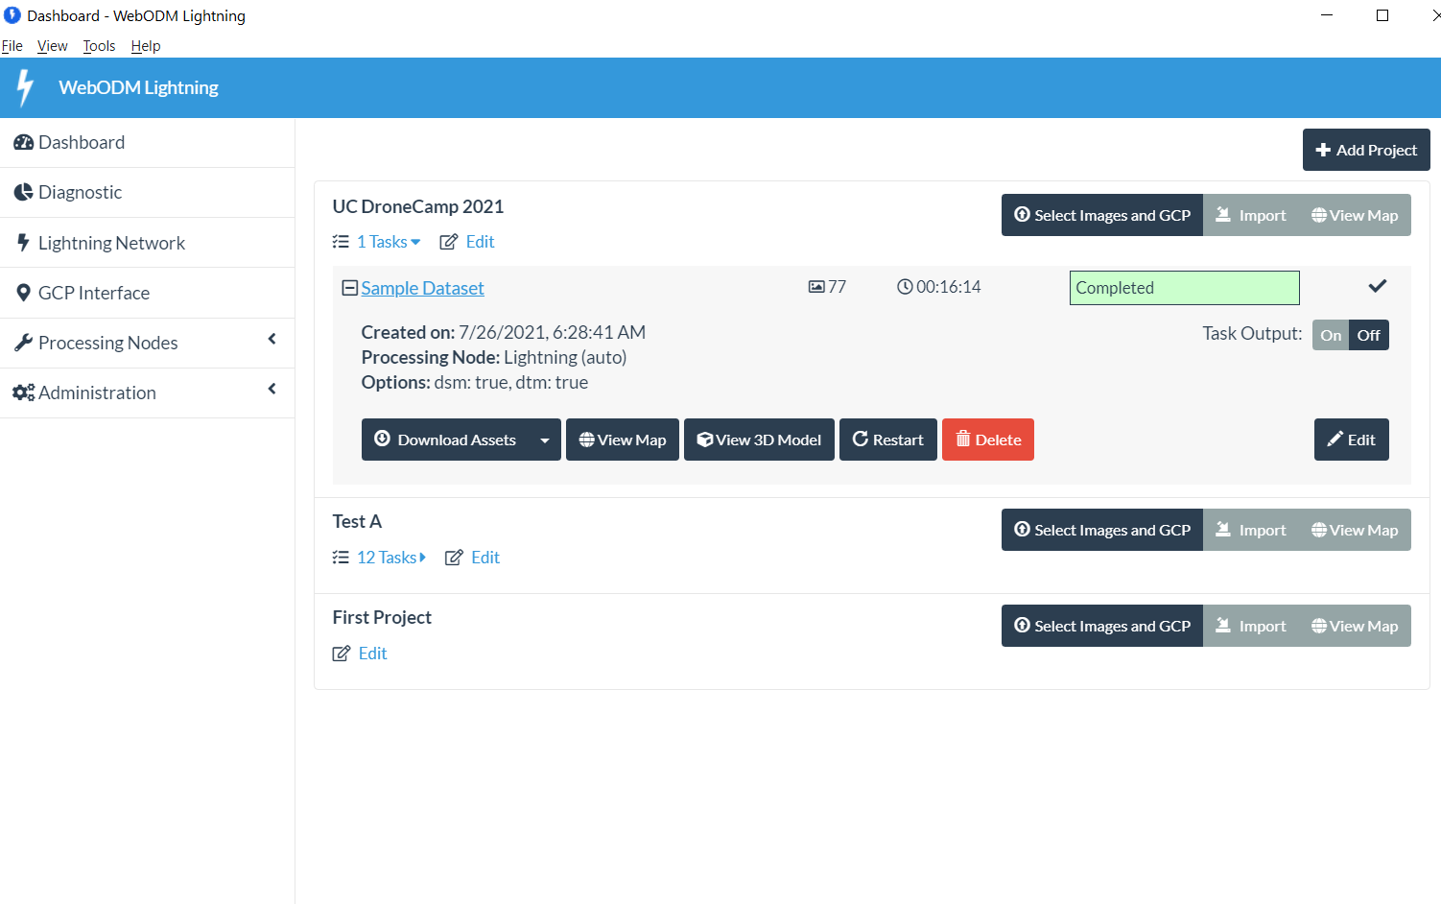
2D Ortho

Slide 24
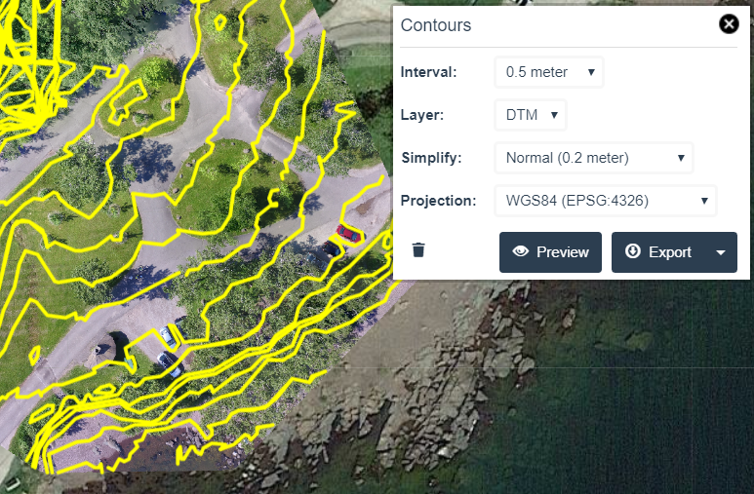
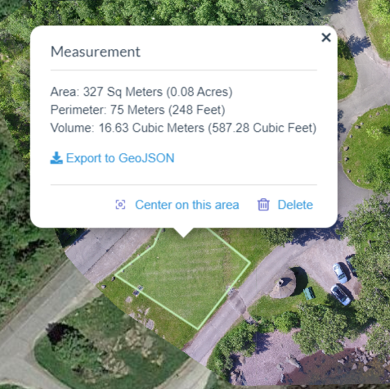
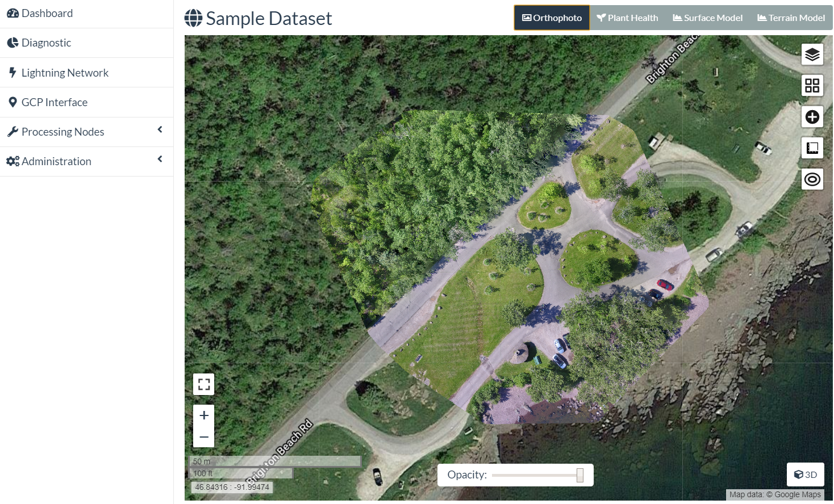
2D Orthophoto
Overlay on Google Map, OpenStreetMap, etc
Measurements (linear, area, volume)
Contour Lines
→ QGIS/ArcGIS
→ Object detection/counting via FieldMapR, rastervision.io

Slide 25
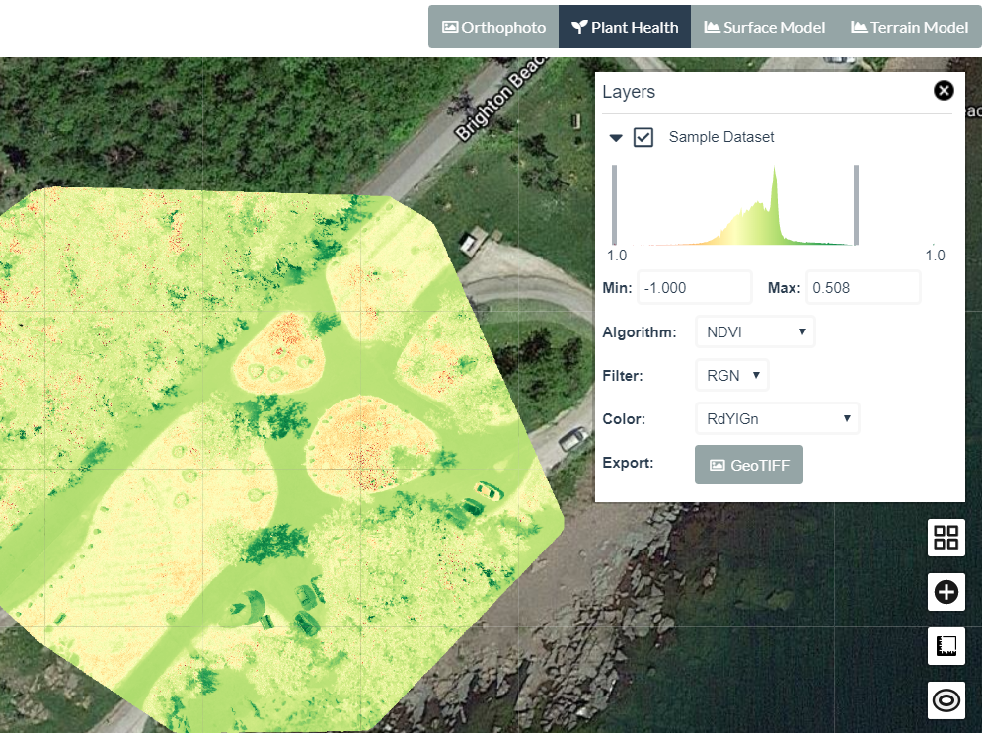
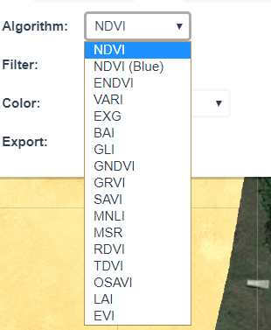
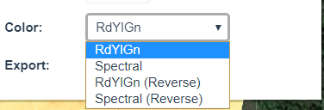
Plant Health Index
Images from multi-spectral cameras (Micasense, Sentera, etc)
Wavelengths beyond visible spectrum
Algorithms: NDVI, RDVI, GLI, SAVI, more

Slide 26
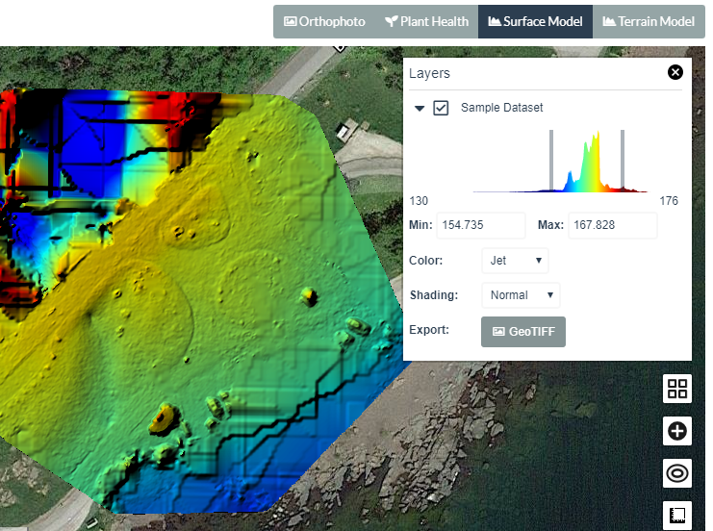
2D Surface Model (DSM)
Highlights surface altitude
Adjustable color ramps
Export GeoTIFF

Slide 27
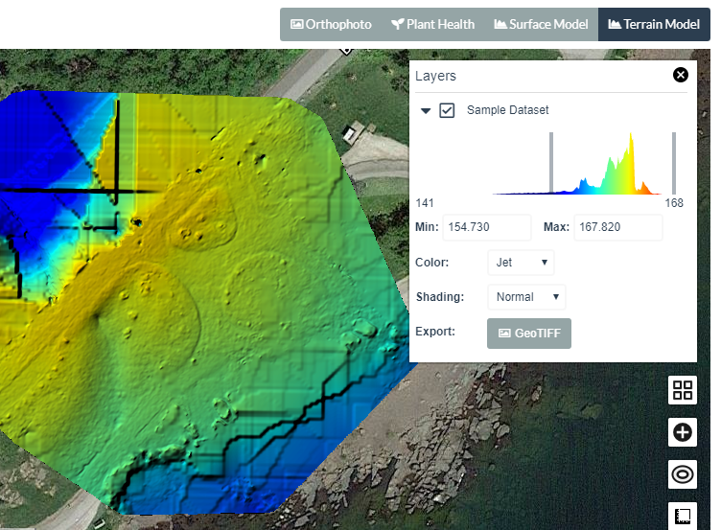
2D Terrain Model (DTM)
“The DSM without the trees”
Uses point classification to remove objects from the surface model
Ground (terrain) profile
Contour lines

Slide 28
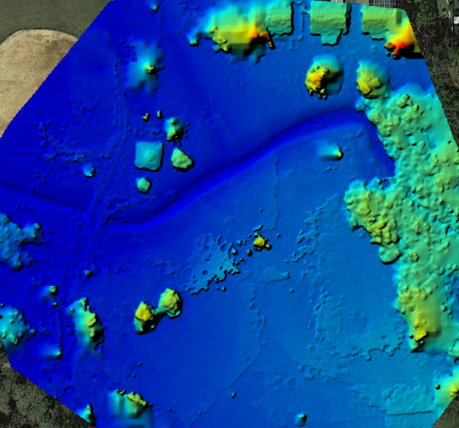
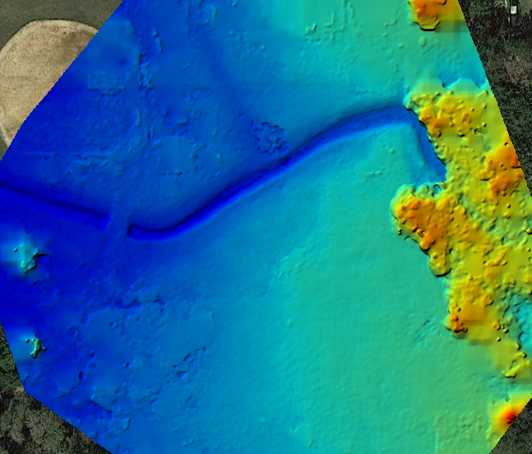
2D Terrain Model (DTM)
DSM
DTM
Images: opendronemap.org

Slide 29
3D Model

Slide 30
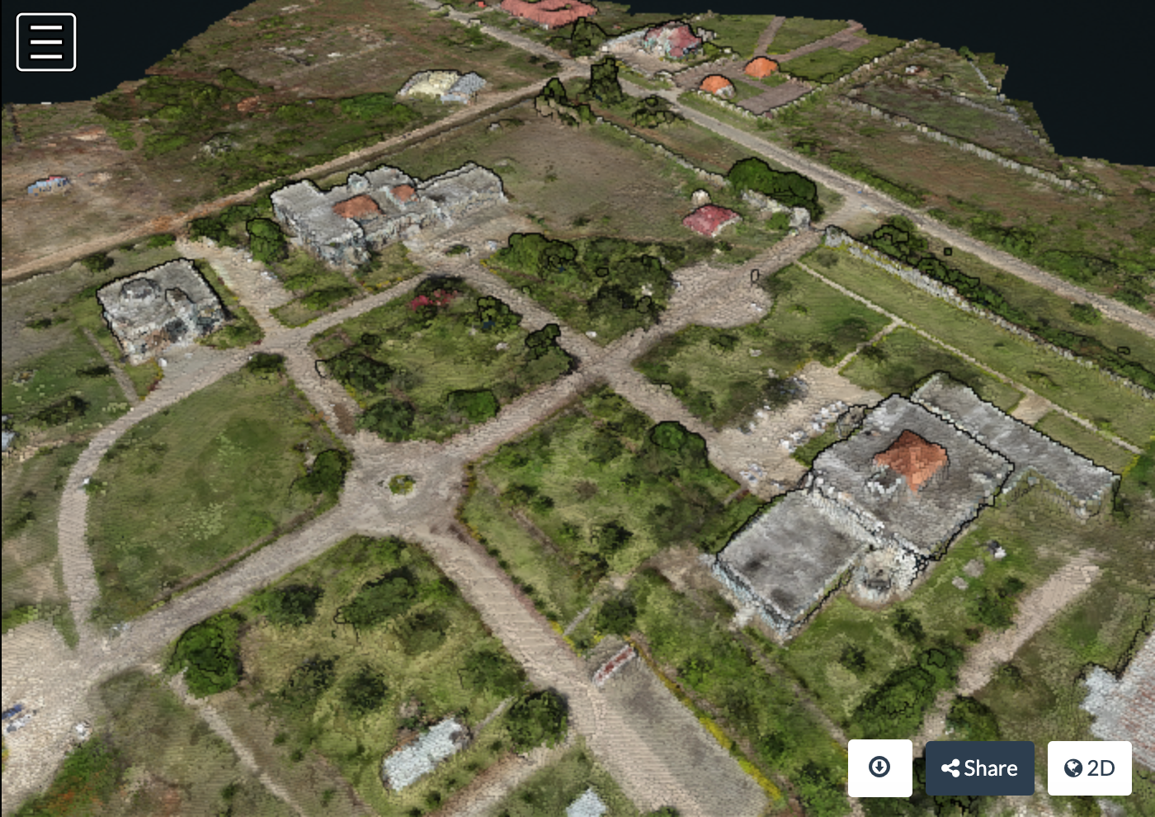
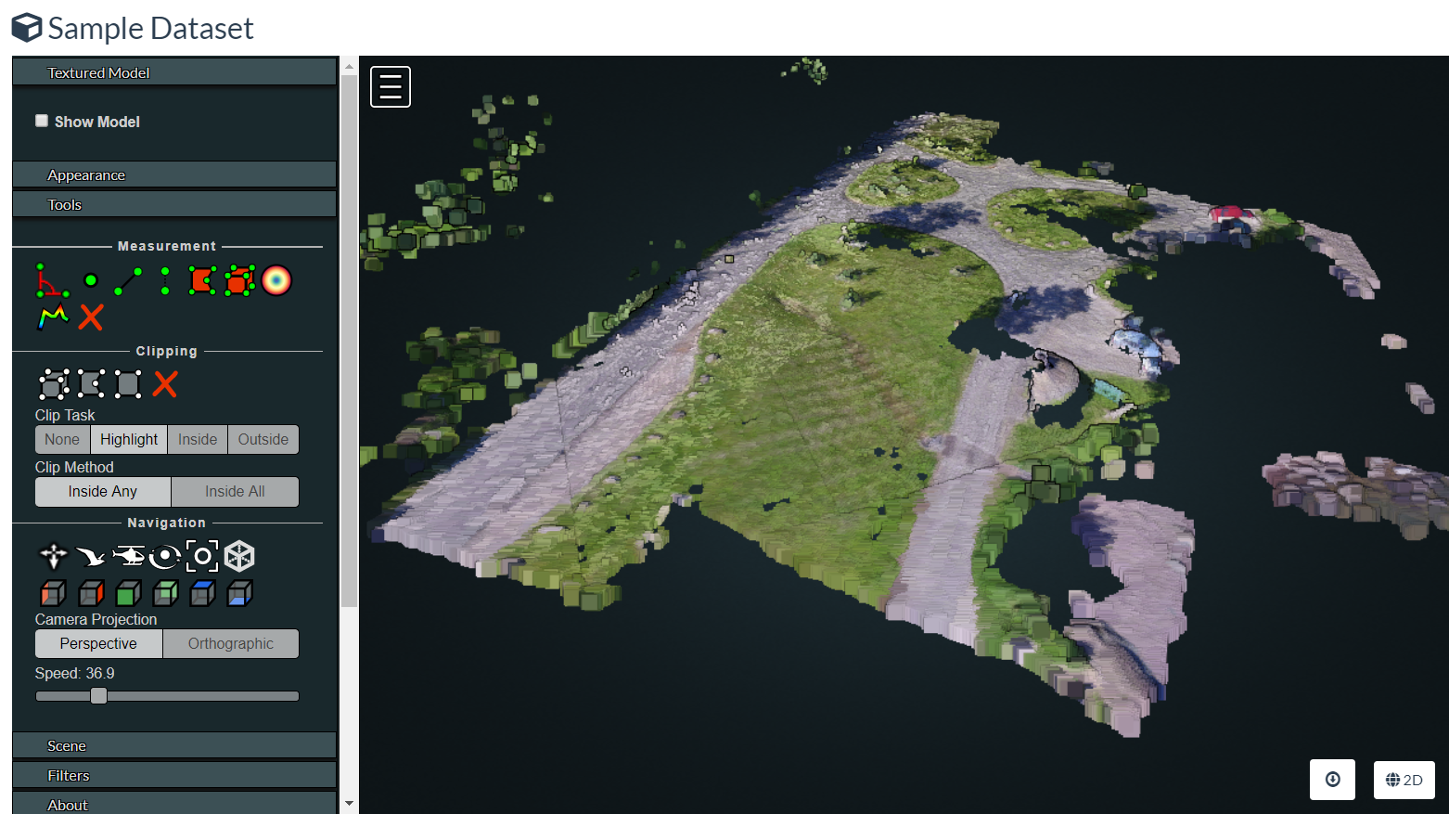
Point Cloud
Individual points
X, Y, Z
Measurements
→ CloudCompare for analysis
Image: opendronemap.org

Slide 31
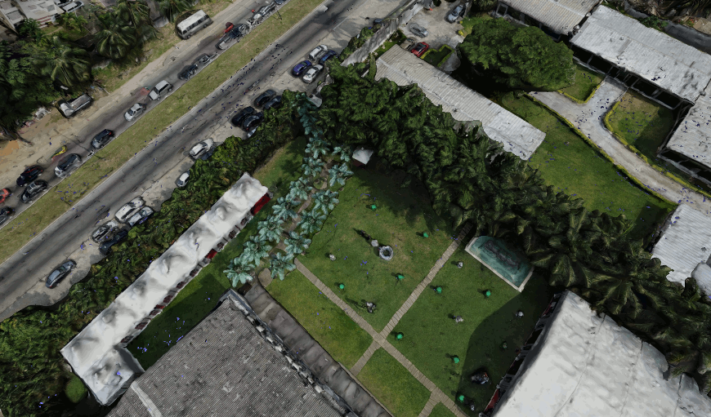
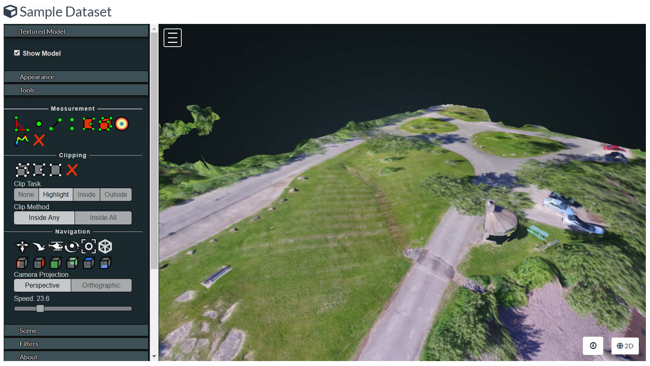
Textured Model
Identify surface triangles
Point Cloud -> Surface Mesh
→ Sketchfab, et al for sharing
→ CAD, Blender
→ 3D print
Image: opendronemap.org

Slide 32
3D Measurements
Linear
Area
Angle
Height
Height Profile
Volume

Slide 33
Download
Orthophoto (GeoTIFF)
Terrain Model / DTM (GeoTIFF)
Surface Model / DSM (GeoTIFF)
3D Point Cloud (.laz)
3D Textured Model (.obj)
Camera Parameters
Quality Report
Everything (all.zip)

Slide 34
Using ODM

Slide 35
Supported Systems
Windows 10 (Docker, or native)
Ubuntu Linux (Docker, or native)
MacOS
16+ GB RAM (more is better)
50+ GB Disk (more is better)

Slide 36
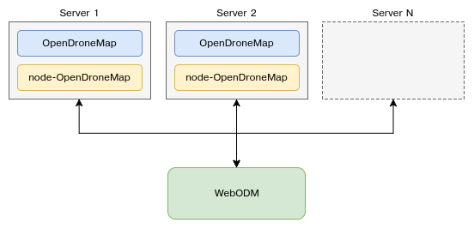
Ways to Use ODM
WebODM – most common
Manual (free)
or, Installer ($)
WebODM Lightning – easiest
Process on Lightning servers ($)
Command Line ODM
API (NodeODM)
LiveODM (USB or DVD) ($)
Portable OpenStreetMap (POSM)
Diagram: opendronemap.org

Slide 37
Common Problems
Many paths to get started with ODM.
Where to start?
All require some work
Jumping in with a large dataset (start small!)
System resources
Machine spec
Docker allocations
Processing is hung (or is it?)
Processing failed, but not sure why
Output quality vs. expectation

Slide 38
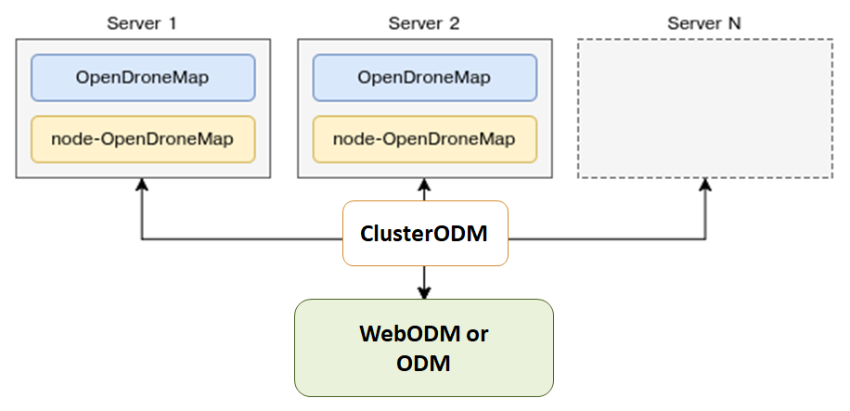
Large Datasets
Split/Merge
ClusterODM
Diagram: opendronemap.org

Slide 39
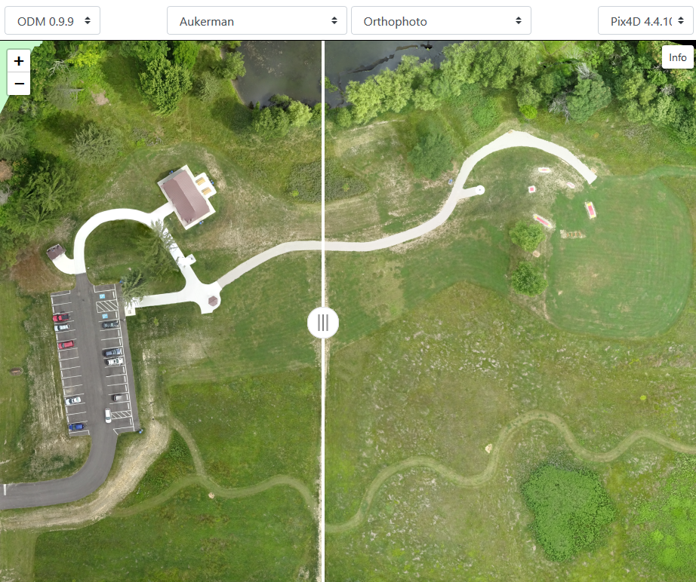
Output Quality
Comparable to commercial products
Commercial output quality can be better with:
Default settings
Poor flight coverage
ODM produces comparable quality with:
Sometimes with default settings
Often with tuned settings
Good flight coverage (overlap, multiple POV)
https://opendronemap.github.io/UAVArena/

Slide 40
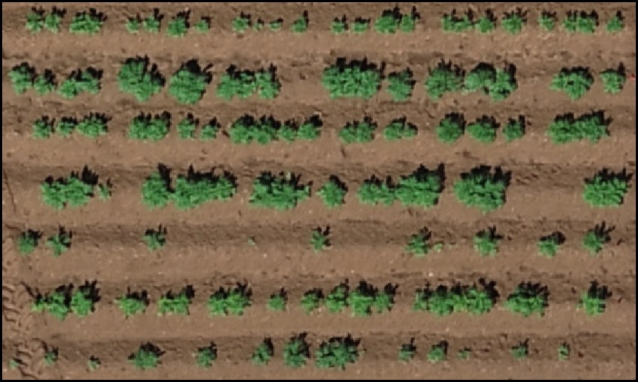
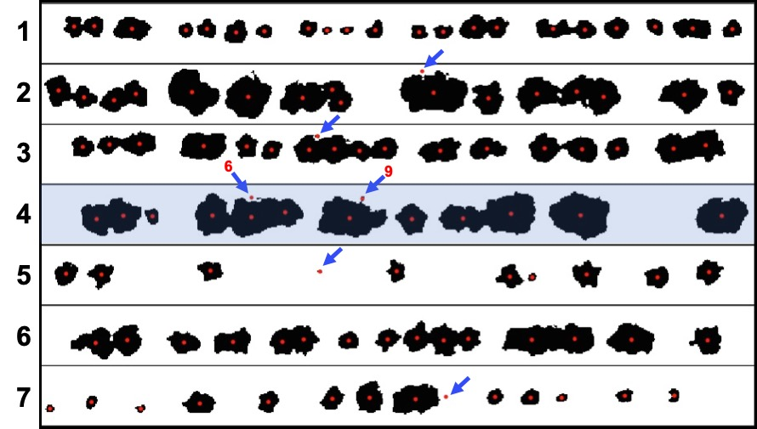
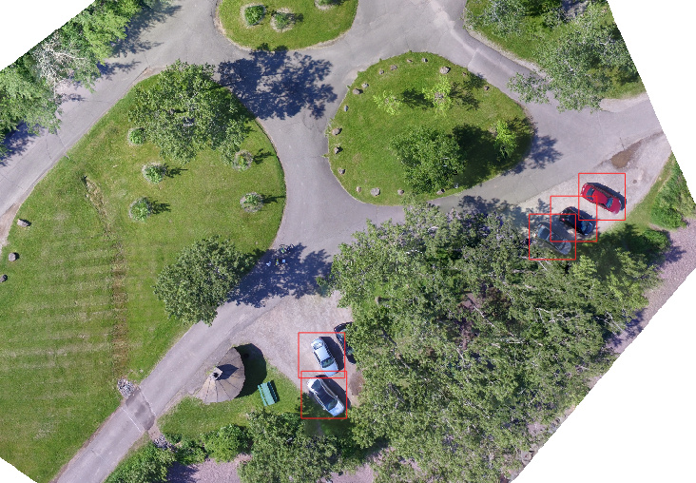
Object Detection, Counting, Analysis
Documented workflows using external tools (not within ODM)
FIELDimageR
“A Tool to Analyze Orthomosaic Images From Agricultural Field Trials in R”
https://www.opendronemap.org/fieldimager/
rastervision.io

Slide 41
Summary

Slide 42
Output Summary
2D outputs
Orthophoto
Terrain/Surface Models
Plant Health
3D outputs
Point cloud
Textured mesh

Slide 43
ODM Summary
ODM is Open Source, with benefits in
Cost
Control
Complex to start, can be fiddly to use
Output quality is comparable to commercial software
Community has momentum

Slide 44
Learning More

Slide 45
UAV Arena
Compare Outputs
ODM
Pix4D
DroneDeploy
Agisoft Metashape
DroneMapper
https://opendronemap.github.io/UAVArena/

Slide 46
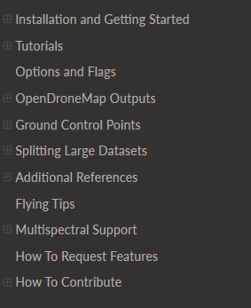
ODM Docs
https://docs.opendronemap.org

Slide 47
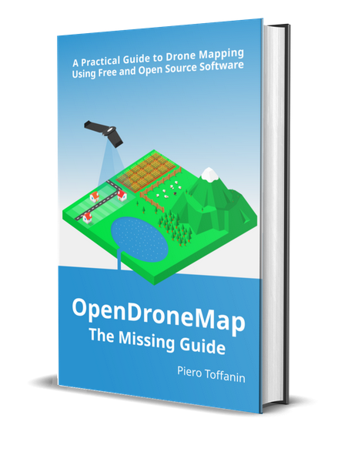
ODM Book
https://odmbook.com
$30
Image: odmbook.com

Slide 48
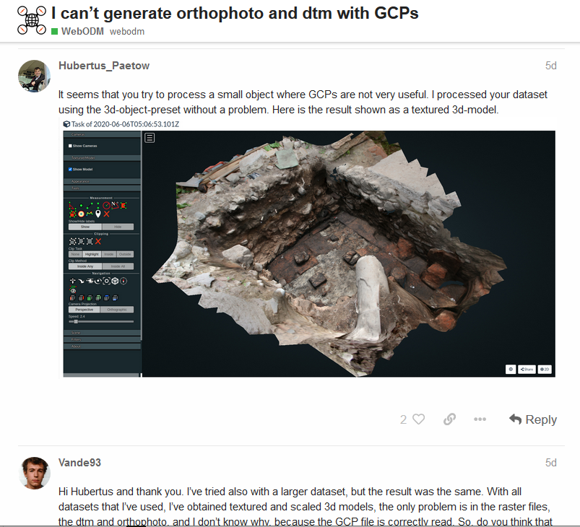
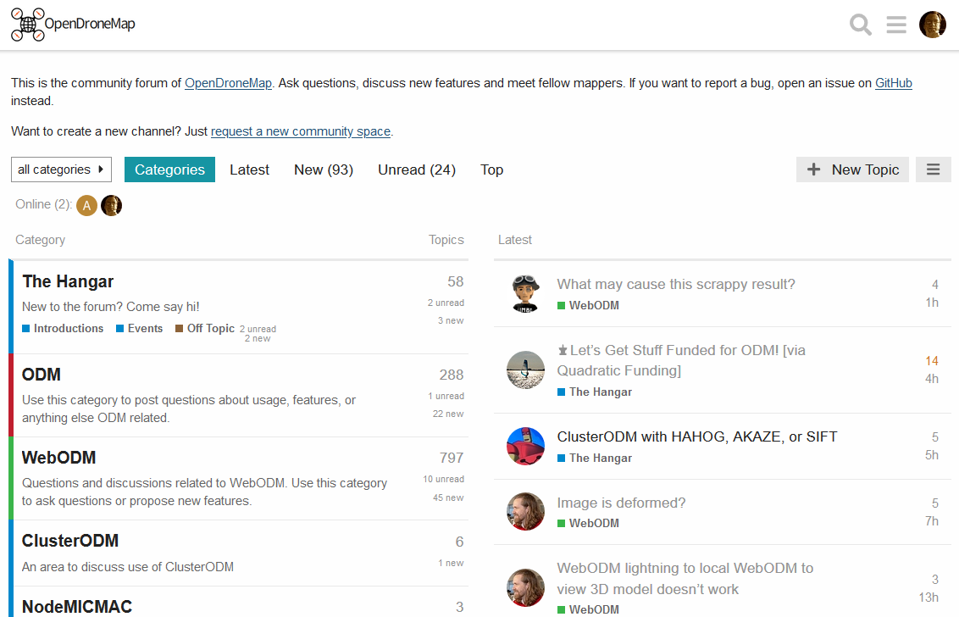
Community Forum
https://community.opendronemap.org

Slide 49
Hands-On: Part B
Working with Outputs

Slide 50
WebODM vs. WebODM Lightning
WebODM
Install for free
Process locally for free
WebODM Lightning
Commercial service
Install for free
Process in the cloud ($)

Slide 51
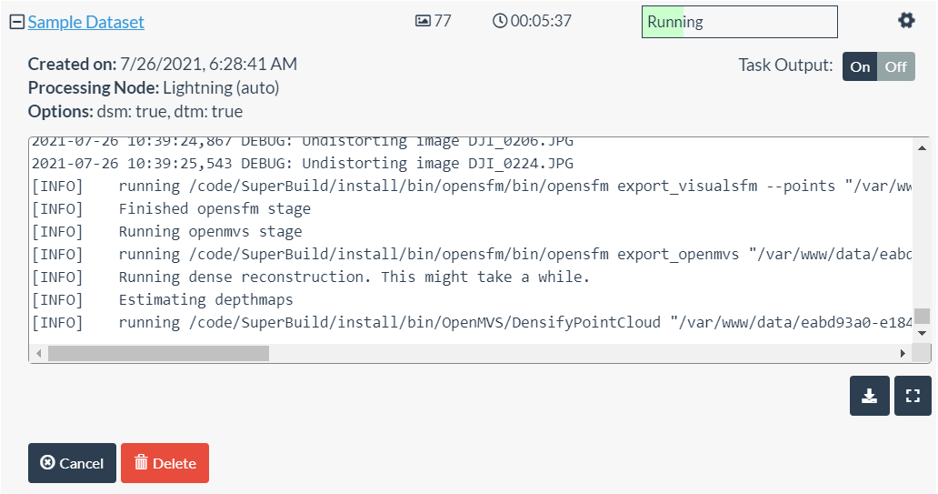
Still Running?

Slide 52
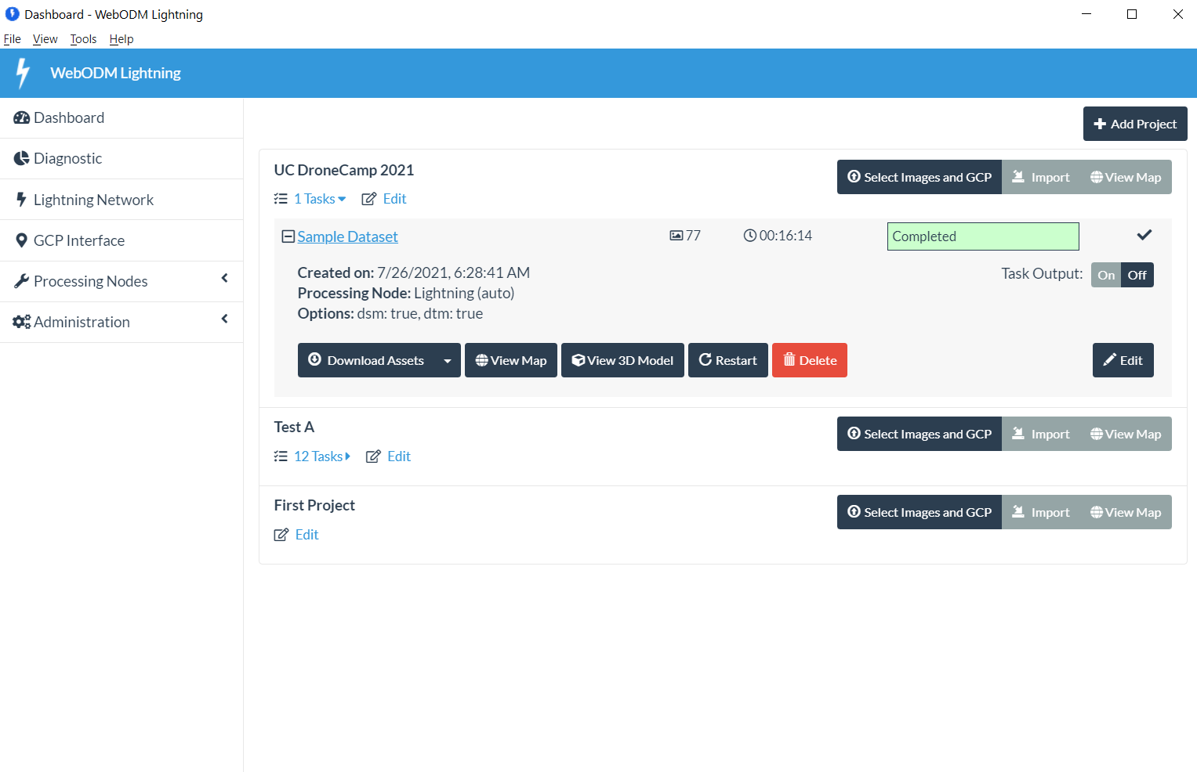
Finished
Today, Speed > Quality

Slide 53
Exercises – 2D Orthophoto

Slide 54
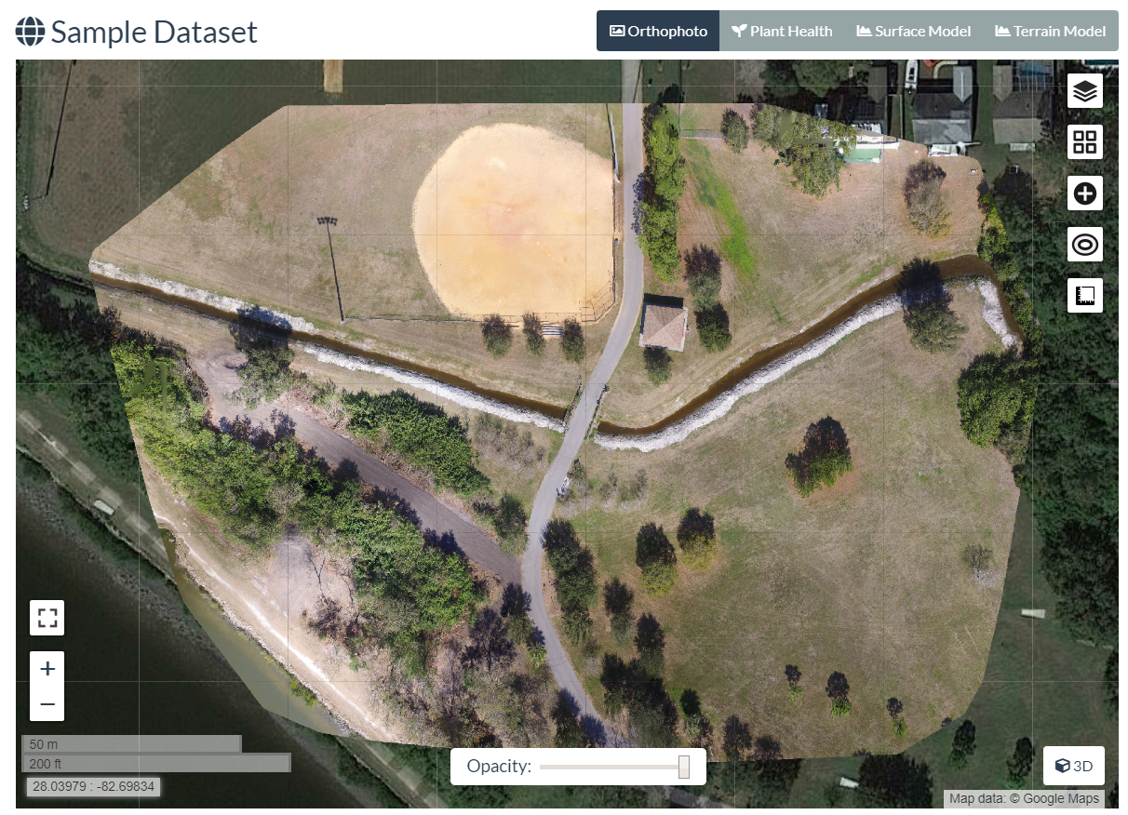
#1 – Orthophoto - Navigate
Click+hold = move map
Scroll wheel = zoom in/out
Map controls +/- = zoom
Map control square = full screen
Top buttons:
Ortho
Plant Health
Surface Model
Terrain Model

Slide 55
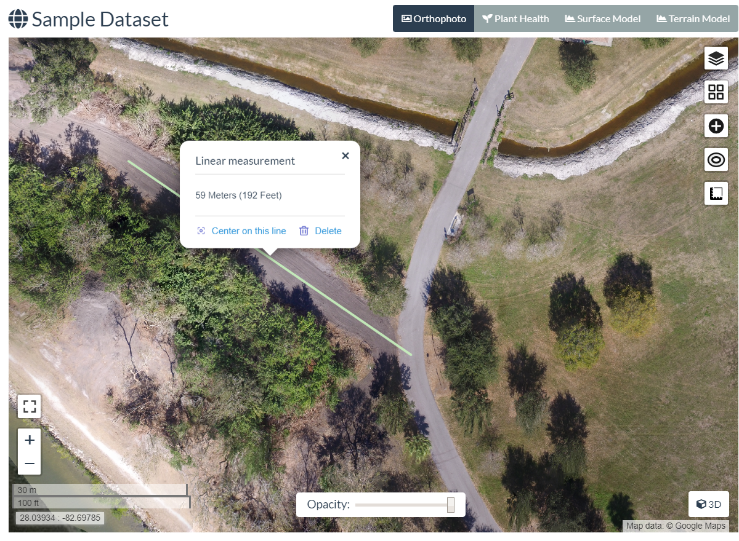
#2 – Orthophoto - Measure
Click ruler (5th on right)
Create new measurement
Click 2 points on map
Click “Finish measurement”
View calculations in white balloon
Close balloon with “x”
Click ruler again, new measurement
Click 4 points on map to make a box, click “Finish”
View calculations
Click “Delete” to remove it

Slide 56
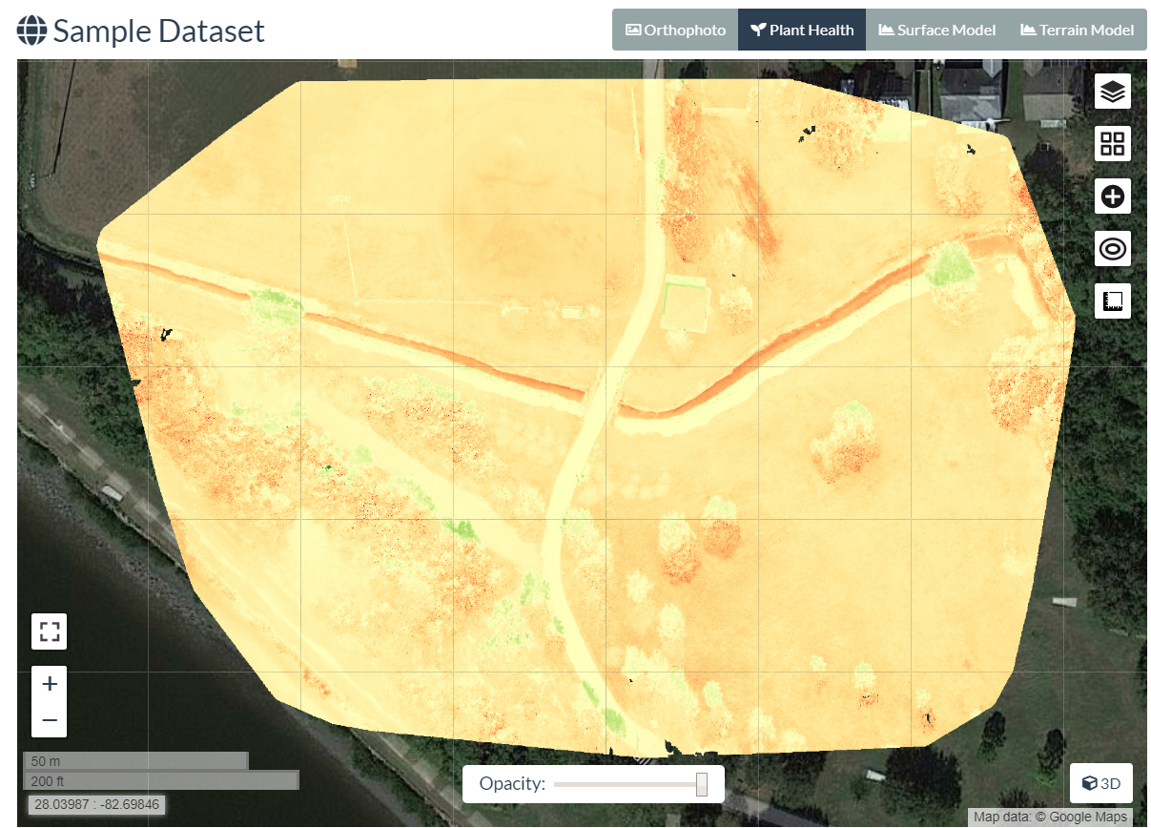
#3 – Plant Health
2nd Top Button: Plant Health
Note color differences in different grassy areas
Click top right “layers” icon
View “Algorithm” options
View “Color” options
Drag min/max bars
Export GeoTIFF

Slide 57
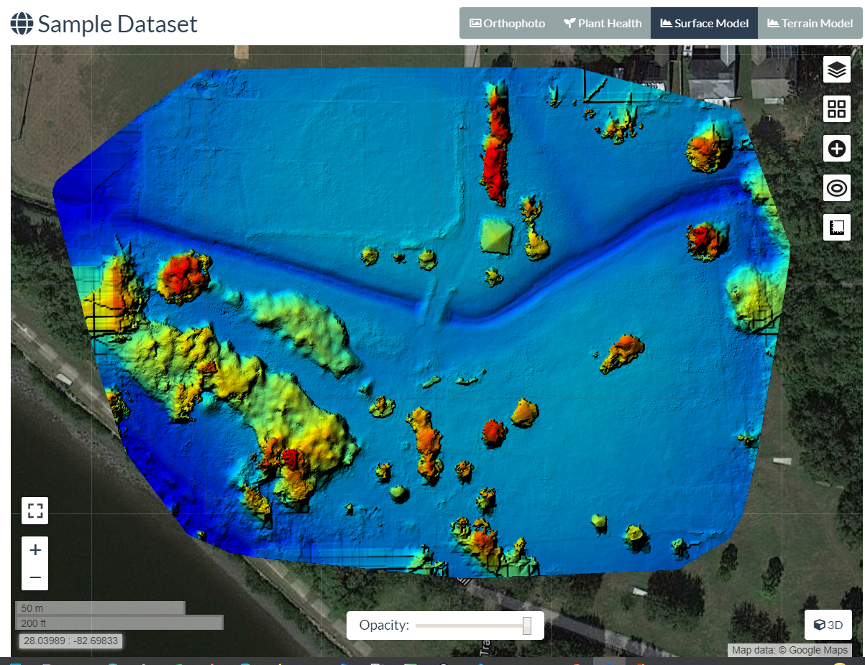
#4 – Surface Model (DSM)
3rd Top Button: Surface Model
Wait for calc/load
Note color varies by altitude
Click top right “layers” icon
View “Color” options
Drag min/max bars
Wait for refresh
Export GeoTIFF

Slide 58
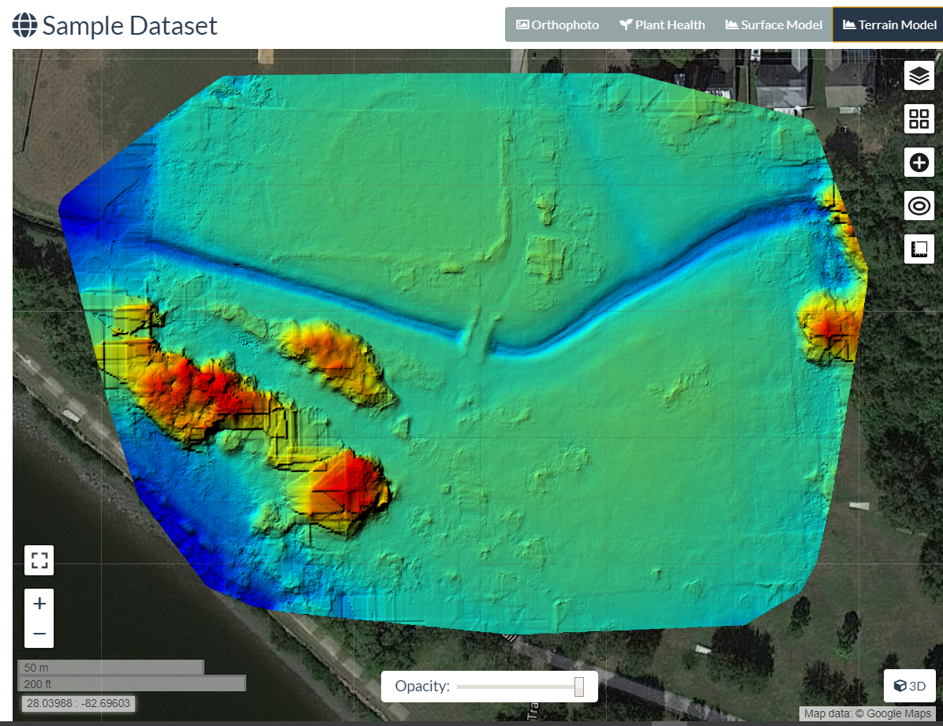
#5 – Terrain Model (DTM)
4th Top Button: Terrain Model
Wait for calc/load
Note color varies by altitude
Click top right “layers” icon
View “Color” options
Drag min/max bars
Wait for refresh
Export GeoTIFF

Slide 59
Exercises – 3D Model

Slide 60

#6 – 3D Model - Navigate
Left click+drag = rotate model
Right click+drag = move model
Scroll wheel = zoom in/out
Top left (3 bars) button = collapse tools
Top left (map) button = show model location
Tools
Measure
Navigation
Appearance
Scene

Slide 61

#7 – 3D Model – Measure (Linear)
Adjust the model so you can see
Click 3rd Measurement tool (angled line)
LEFT click 2 points on the map
Now RIGHT click the last point to finish
View measured distance (m)
Click red “X” in measurement tools, to delete

Slide 62

#8 – 3D Model – Measure (Area)
Adjust the model so you can see
Click top right Measurement tool (red box)
LEFT click 4 points on the map
Now RIGHT click the last point to finish
View measured distances (white)
View measured area (green)

Slide 63

#9 – View Textured Model
Find “Textured Model” near the top of the tool menu
Click to expand, then click “Show Model”
Wait a few seconds
View how the scene becomes more detailed, holes are filled
Uncheck and check the box to turn off, and on
Move the model around to view other parts
Edges of model = lots of error Interior of model = better precision

Slide 64

#10 – View Cameras
Find “Cameras” near the top of the tool menu
Click to expand, then click “Show Cameras”
Zoom out (scroll) until you see the blue squares floating above the scene
Note positions, angles of cameras
Click one camera to see the photo from that position

Slide 65
Exercises – Download

Slide 66

#11 – Download Specific Outputs

Slide 67





#12 – Download All

Slide 68


Contact Me
corey@twomile.com
https://www.linkedin.com/in/coreysnipes
This material is based on presentations by:
Stephen Mather - ODM, Cleveland Metroparks
Piero Toffanin - ODM, UAV4GEO
Screenshots and interface images by
Corey Snipes, unless otherwise noted.
coreysnipes
twomileheavy
Thank You!
https://opendronemap.org

Slide 69
Backup

Slide 70


